Slide 1

BIOLUMINESCENCE
S.LAKSHMI SIRISHA
324103210194

Slide 2
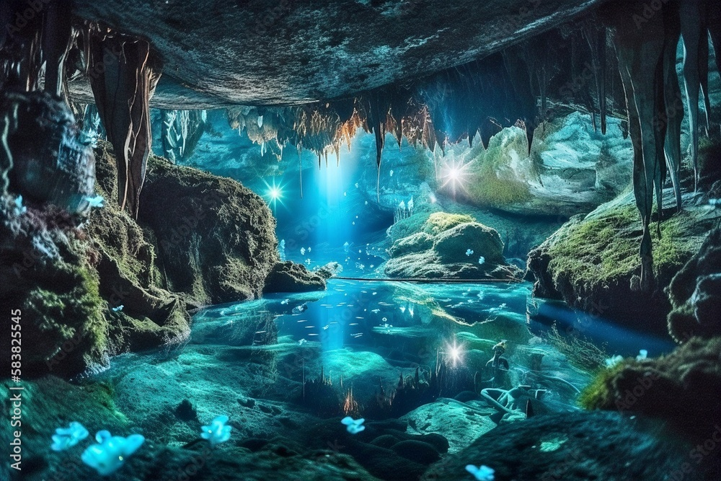

Slide 3
Bioluminescence is the ability of living organisms to produce and emit light. It occurs when chemical reactions, called chemiluminescence, take place within or on the organism, releasing energy that produces light

Slide 4
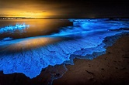
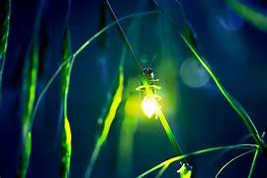
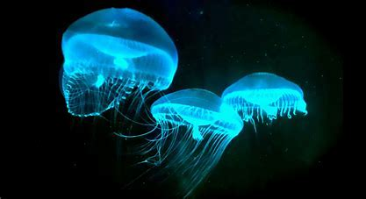
Firefly
“Use light to communicate”

Slide 5
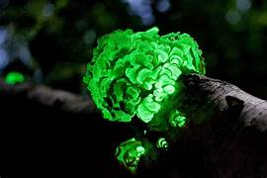
Dinoflagellates near a beach
“Glow in response to movement in water"

Slide 6
Fungus
"Attracts insects for spore dispersal"

Slide 7
Jellyfish
“Uses light to attract prey and communicate”

Slide 8
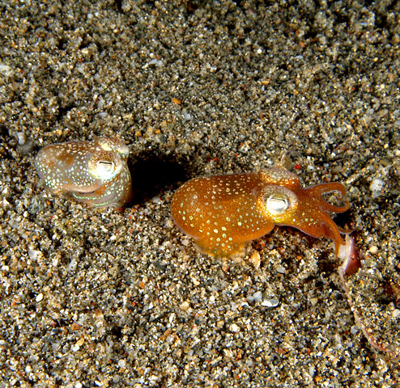
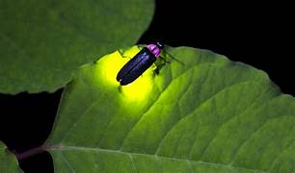
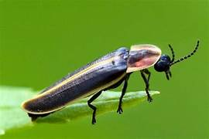

Advantages Disadvantages
*Predator Evasion: The bobtail squid uses light for camouflage. The bioluminescence of the bobtail squid makes it harder to detect by predators, including humans.
*Limited Rang: It is mostly useful in dark environment, such as deep ocean or nighttime, so it’s less beneficial.
*Ecological Disruption: In environments where bioluminescence is rare, the introduction of organisms that produce light (due to environmental changes or invasive species) can disrupt local ecosystems. This could affect predator-prey relationships and other biological interactions
*Research: Bioluminescence is used in research and biotechnology.

Slide 9
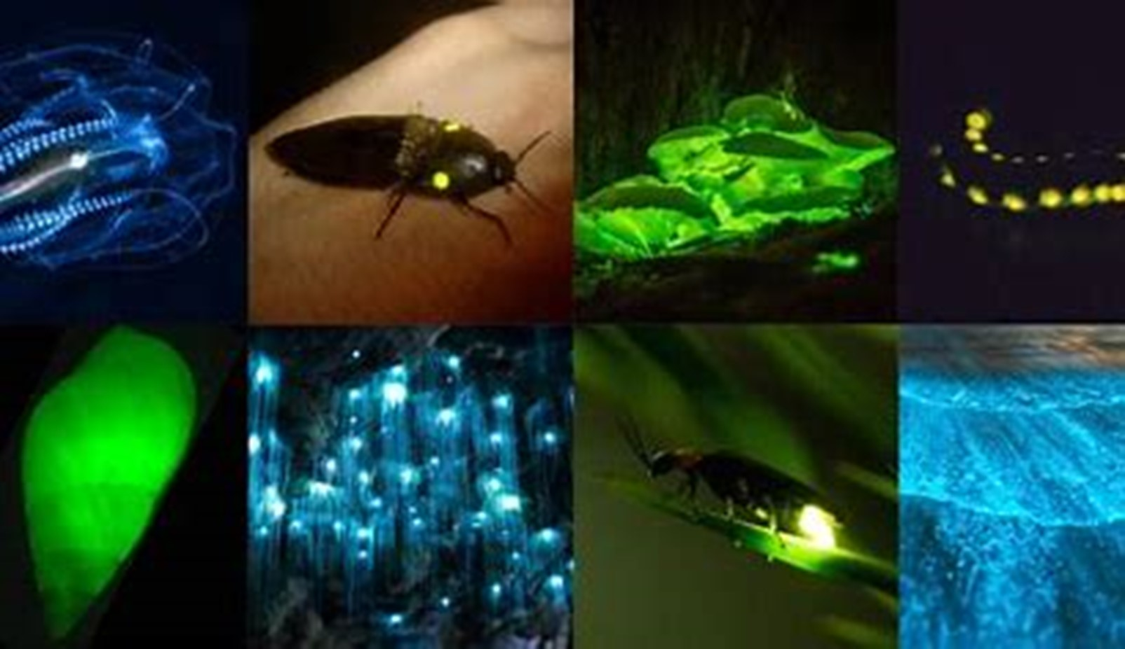
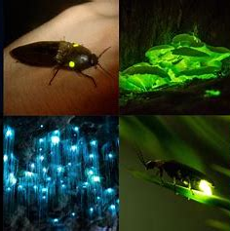
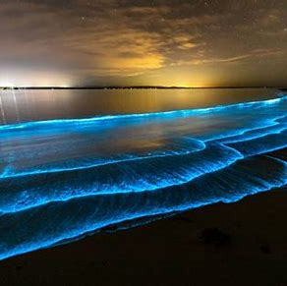
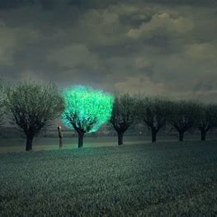
Ancient Times: Glowing organisms observed.
19th Century: Discovery of luciferin and luciferase.

Slide 10

Biotech: Glowing organisms for research.
Medical: Disease tracking and diagnostics.
Environmental: Pollution detection.

Slide 11

Custom Organisms: For sustainable energy.
Medical: Early disease detection.
Eco-lighting: Bioluminescent plants as light sources.

Slide 12
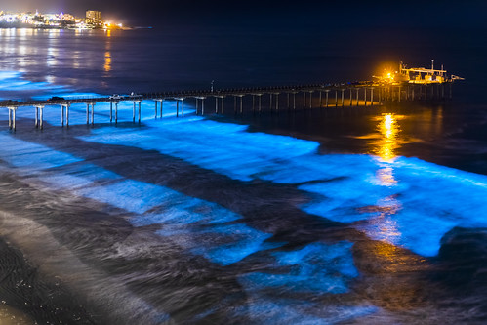
CONCLUSION:
Bioluminescence has evolved from a natural curiosity to a valuable tool in fields like medicine, diagnostics, and eco- friendly lighting. Its advantages include real-time, non-invasive monitoring and potential for sustainable applications. However, Challenges like cost, scalability, and environmental impact remain. In the future, it could contribute significantly to energy efficiency and medical advancement.

Slide 13
THANK YOU

